Slide 1

NBA Game Revenue Optimization

Slide 2
Exploratory Data Analysis (EDA)

Slide 3
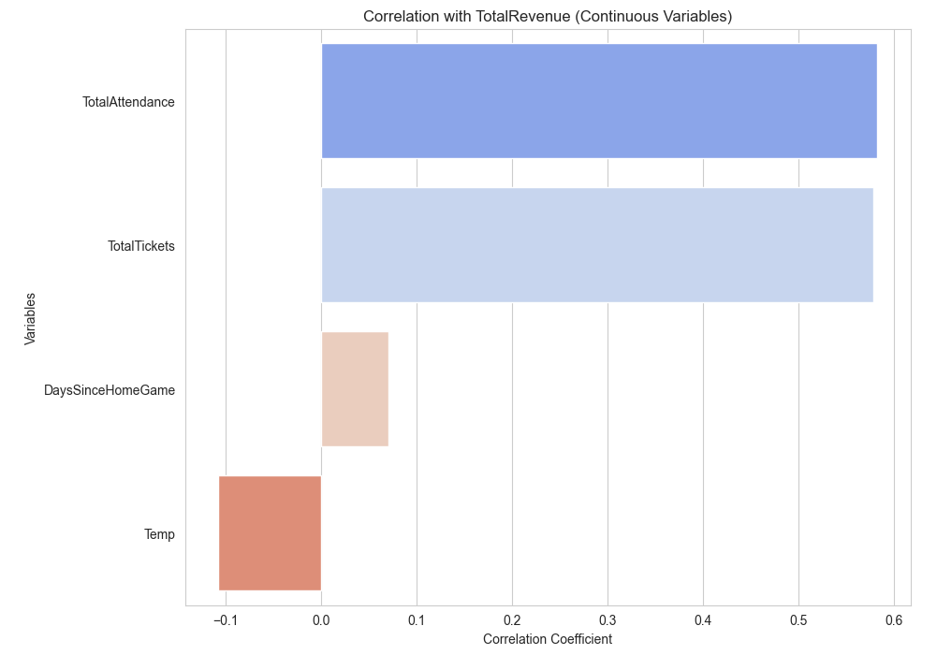
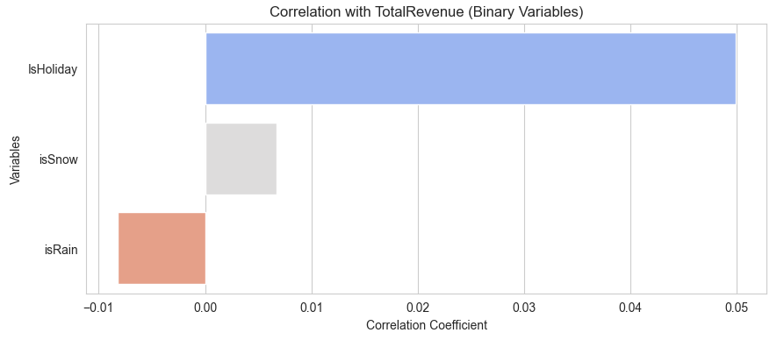
Correlation: binary-continuous variables correlation with TotalRevenue

Slide 4
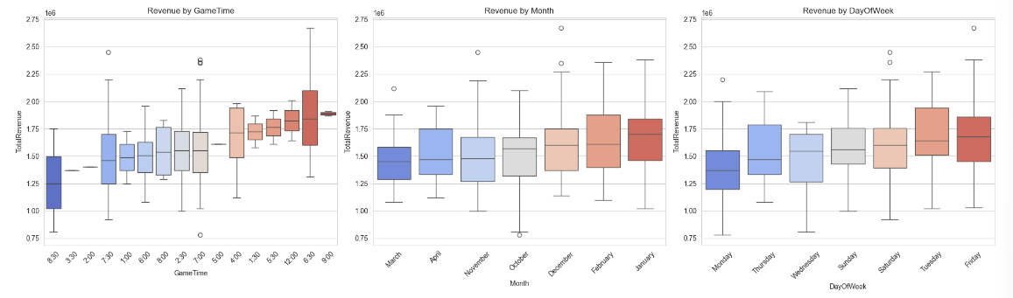
Box-Plot: Factor Relate to TotalRevenue

Slide 5
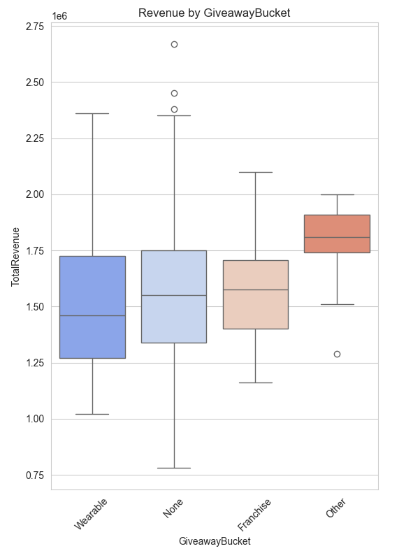
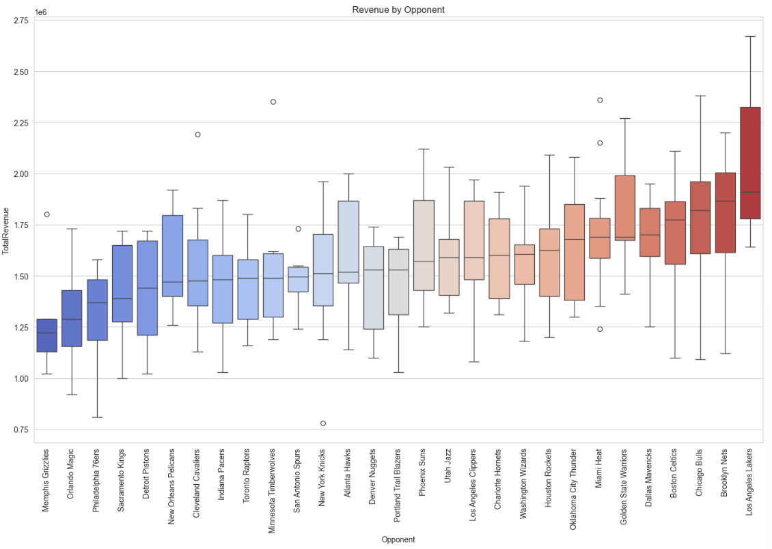

Slide 6
Model Evaluation

Slide 7
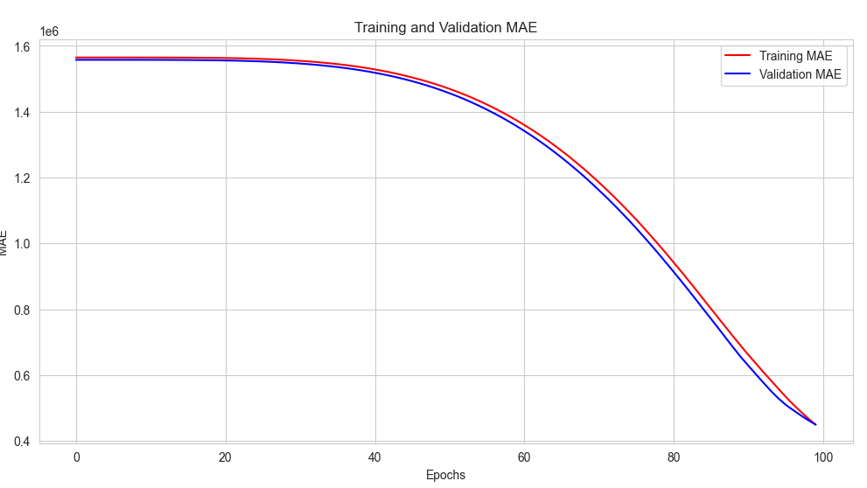
Neural Network: Training and Validation MAE

Slide 8
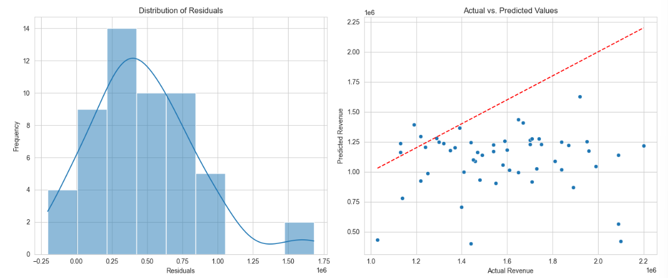

Slide 9
Importance Feature Extraction

Slide 10
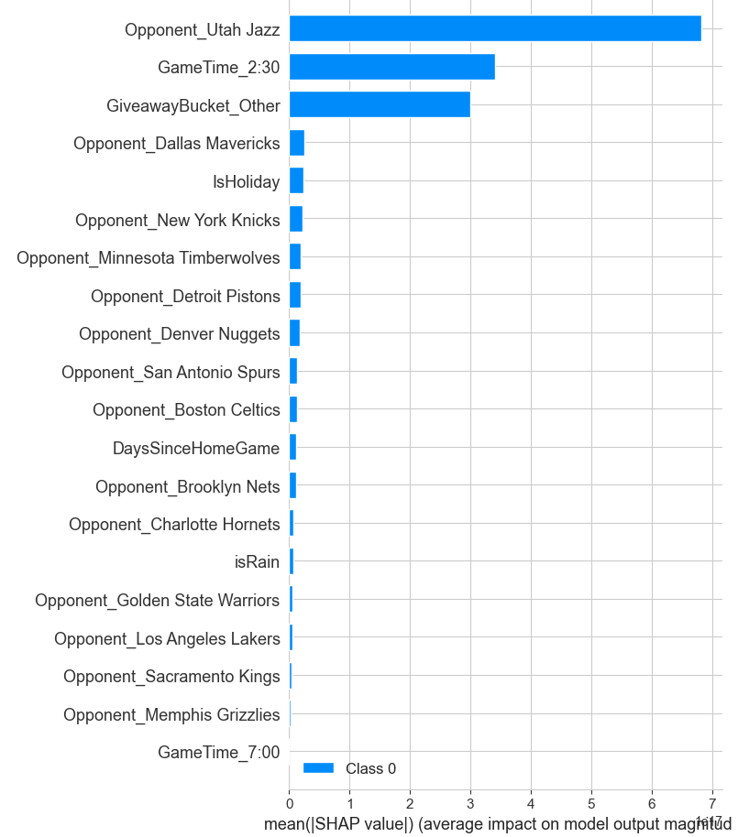
Neural Network: Sharp

Slide 11
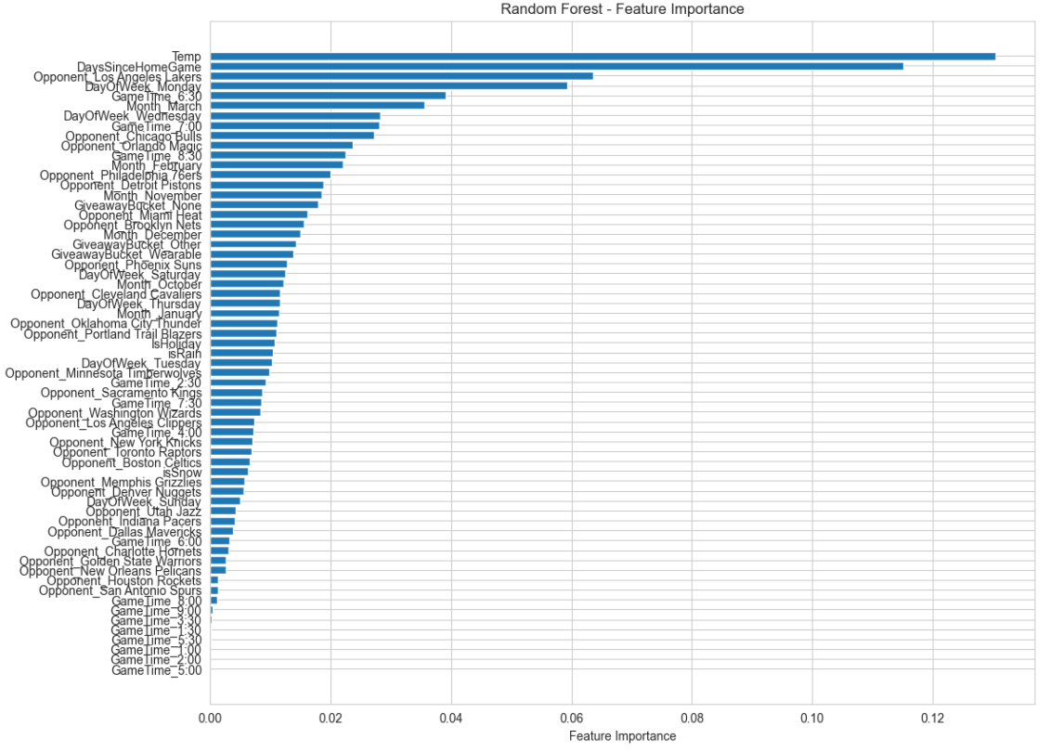
RandomForest Extraction

Slide 12
Optimal Schedule Scenario(8 Games In Mouth)

Slide 13
LP Method: Maximize total expected revenue
Schedule a fixed number of games (10) within a month of 30 days.
Avoid scheduling games on consecutive days to prevent back-to-back games.
Dates when the stadium is unavailable should not have scheduled games.
Best Schedule: [1, 6, 8, 10, 13, 21, 27, 30]

Slide 14
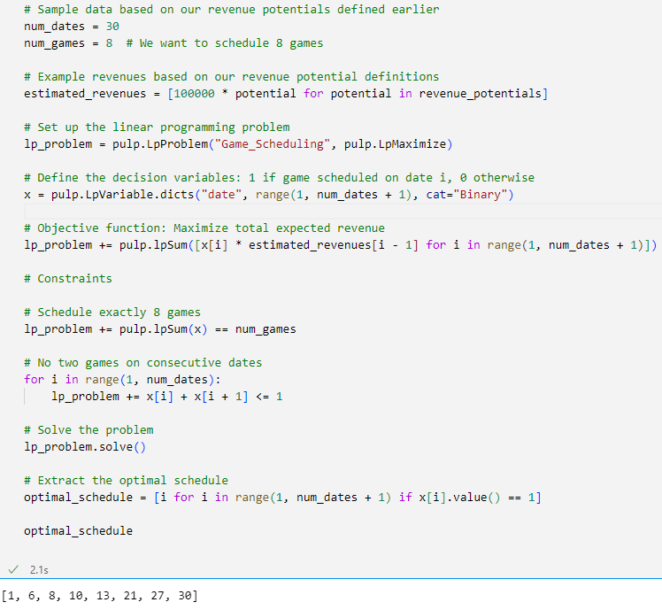

Slide 15
Recommendation

Slide 16
Recommendation and Conclusion
1. Key Influencers:
Opponent Teams: Matches against Utah Jazz, Dallas Mavericks, and New York Knicks draw more revenue.
Game Timing: 2:30 and 7:00 slots generate higher revenues.
Giveaways: Items categorized as "Other" have a notable impact.
Game Date: Holidays and the gap since the last home game matter.
2. Recommendations:
Scheduling: Prioritize popular teams on weekends/holidays.
Timings: Favor 2:30 and 7:00 for key matches.
Engagement: Innovate giveaways to boost attendance.
Frequency: Keep regular home games for sustained fan excitement.
3. Future Steps:
Data: Add player stats and fan engagement metrics.
Model: Explore ensemble models and advanced architectures.
Features: Enhance with specialized metrics.
Updates: Retrain the model regularly.

